Slide 1
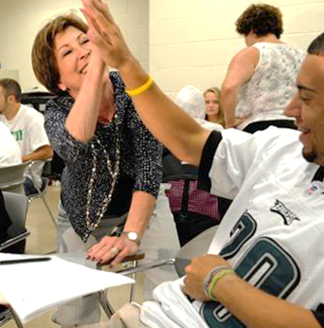
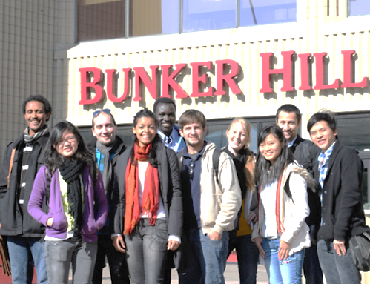
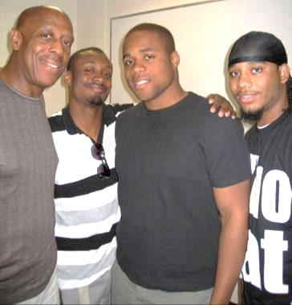
Bunker Hill Community College Dual Enrollment/Early College Program

Slide 2
Dual Enrollment/Early College Program
OVERVIEW: Over 800 students from area schools and community-based organizations earn high school and college credits simultaneously. All classes are taught by BHCC faculty.
BHCC staff advises students on procedures for College Placement Testing, course selection, BHCC enrollment and college expectations and ensures that students are connected to the many academic support programs and resources on campus.
Staff works closely with BHCC faculty and school/CBO guidance counselors/staff to monitor student performance.
Students in Early College programs participate in an accelerated pathway program from high school to college, allowing them to graduate high school with career exploration experience and having earned as many as 12 college credits to an Associate’s Degree.
Dual Enrollment and Early College partnerships advances a mission of equity by focusing on low income, first-generation, students of color.
Partnership activities strive to meet and serve students where they are--at their level of academic need, college awareness, language proficiency, disability, etc.--and are geared toward supporting the success of all participating students.
Through support from the Smith Family Foundation, BHCC is currently working toward a centralized model of Early College to bring the work to scale, gather data and evidence of success and to make a strong case that Early College is a viable solution to talent and economic development.
Notes:
2

Slide 3
Early College Model
Step 1: 9th Grade Exploration
HS based career exploration & college success curricula
Career interest inventories
Step 2: 10th Grade Transition
Continue career exploration & college success curricula
Step 3: 11th & 12th Grades Pathways
Students enroll in 1-2 classes per semester at BHCC with wraparound supports
Internships/experiential learning opportunities
Introductory college courses at HS site
Students develop educational & career plan
Students earn between 15 and 24 college credits
CURRICULUM ALIGNMENT (Math & English)
&
PROFESSIONAL DEVELOPMENT
COLLEGE ENTRY

Slide 4
Curriculum Alignment & Mixed Enrollment Model
Curriculum alignment: BHCC and high school/CBO faculty collaborate to align curricula in English and math to help reduce or eliminate the need for students to take developmental courses.
Mixed enrollment and Cohort models: BHCC is one of the only colleges in Massachusetts with on-site classes at partner high schools that use a mixed enrollment model--high school students taking classes with the general college population rather than only with their cohort of high school students--in its dual enrollment program. Examples of partnerships incorporating a mixed enrollment model include: Malden High School, Everett High School and Cambridge Rindge and Latin High School. The cohort model allows high school students at our partner high schools to take college-level courses at their high school along with their peers. Examples of cohort model partners include: Boston Public Schools, Chelsea High School and Medford High School.

